Slide 1
“Manifest System”
Limassol Cyprus – 12 March 2019
1
Notes:
Department of Customs and Excise

Slide 2
Manifest System
Functionalities Covered :
Arrival Notification
Presentation Notification
Temporary storage
Summary Declaration Status:
Created, Registered, Discharged
Transport Document Status:
Created, Registered, Accepted, Removed, Discharged

Slide 3
Manifest – General Segment

Slide 4
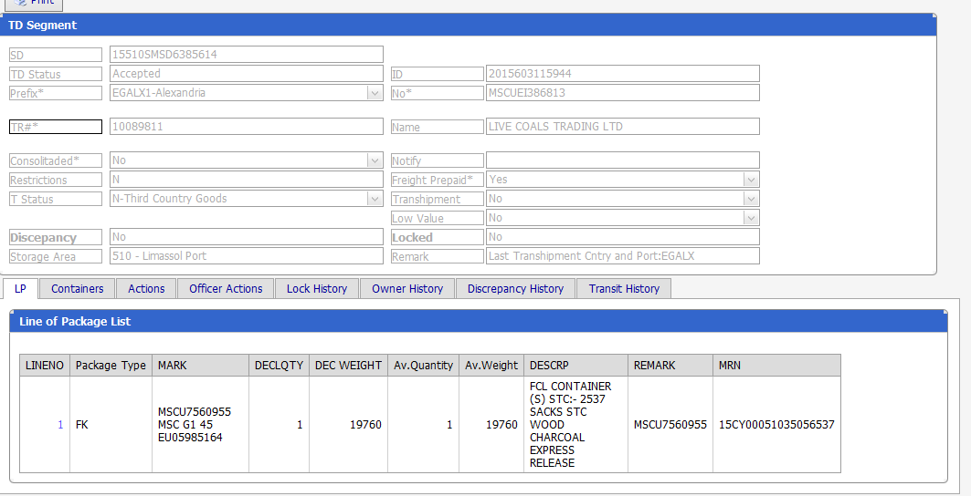
Manifest -Transport Document

Slide 5
Temporary Storage Timers
Manifest System Parameters
90 days for Sea Cargo
45 days for Air Cargo
Then, Transport Document is Locked for Transfer to the Republic’s Warehouse
Management reports are used to identify the Locked TDs

Slide 6
Manifest vs SAD Structure
TD 1
SAD 1
LP1
Item 1
Item 2
TD 2
SAD 2
LP1
Item 1
Cargo
Manifest
LP2
Item 2
Item 3
Example of sea cargo manifest on import
TD 3
SAD 3
LP1
Item 1
….
LP2
Item 2
LP3
Item 25
CT 1
CT 2
Corresponding SADs (one to one with TDs)
Items according to the nature/origin/relieves of the goods
Non consolidated Transp. Documents
Lines of Packages according to the packaging of the goods

Slide 7
Import System – SAD General Segment

Slide 8
Import System – SAD -Items segment

Slide 9
Risk Analysis on Imports
Integrated with the THESEAS Import system
Risk is assessed according to the information presented on the SAD and the Manifest
Main Risk Processes: Profiles, Objects, Result tables, Sampling

Slide 10
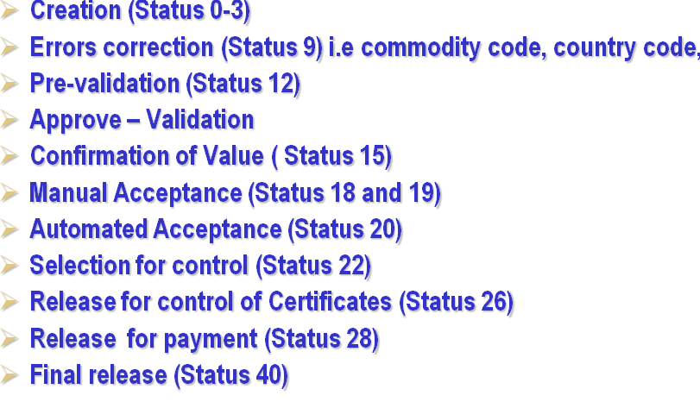
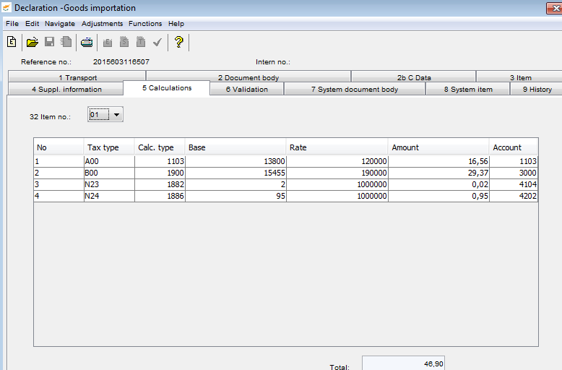
Imp. System- Main Declaration Processes

Slide 11
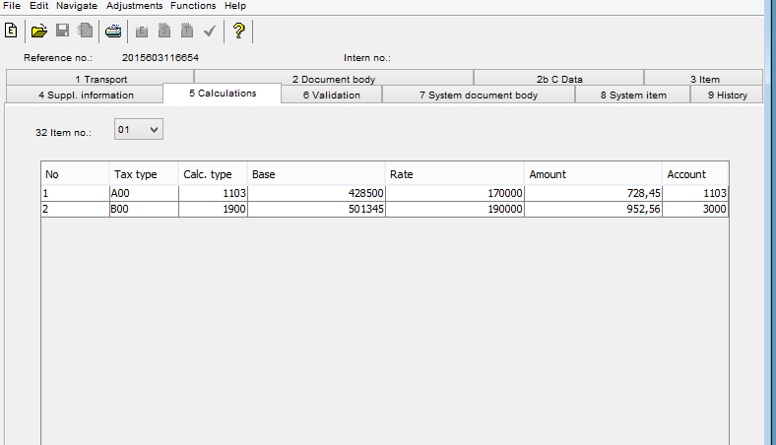
Import – Accounting
Records assessment created in the import system.
Release of Goods after payment is secured.
For each measure there is an account
A group of accounts Nos belong to the same Budget code

Slide 12
Import - Accounting Interface

Slide 13
Traceability in THESEAS ICS-Manifest-Import-Accounting

Slide 14
Follow of Cargo for Exportation
Submission of Export Declaration or Notification
Risk Analysis and Control
Release Goods for Export
Presentation to Office of Exit-Issue of Loading Permit
Control-Supervision of loading-Discharge of previous Procedure
Submission of Export Manifest
Discharge of goods from Export Manifest

Slide 15
End of Presentation

